Slide 1

Vehicle
Detection
Using OpevCV
Team Menbers: -
T. Pranav Moorthy
R.J. Sudharsen
M.K. Mageshwaran

Slide 2

Abstract
Vehicle detection is a crucial aspect of intelligent transportation systems and plays a significant role in various applications, including traffic monitoring, surveillance, and autonomous driving. This project focuses on implementing a vehicle detection system using OpenCV, a powerful open-source computer vision library. The approach involves employing pre-trained classifiers, specifically Haar cascades, for real-time object detection. The process includes image preprocessing, feature extraction, and post-processing steps to enhance the accuracy and reliability of vehicle detection.

Slide 3
Introduction
Vehicle detection using OpenCV involves utilizing computer vision techniques to identify and locate vehicles in images or video streams. OpenCV (Open Source Computer Vision Library) is a popular open-source library for computer vision and image processing tasks. It provides a variety of functions and tools that make it easier to work with images and videos.
Steps for Vehicle Detection:
Image Acquisition:
Capture or obtain the images or video frames that you want to analyze for vehicle detection.
Preprocessing:
Convert the images to grayscale to simplify processing. Apply any necessary preprocessing techniques, such as noise reduction or contrast adjustment.
Object Detection:
Use OpenCV's pre-trained classifiers, such as Haar cascades or deep learning models like YOLO (You Only Look Once) or SSD (Single Shot Multibox Detector), for object detection.
Feature Extraction:
Extract features from the detected objects to identify specific characteristics of vehicles.
Post-processing:
Eliminate false positives and refine the detection results. Apply non-maximum suppression to remove redundant bounding boxes and keep only the most confident detections.
Visualization:
Draw bounding boxes around the detected vehicles to visually represent the results.

Slide 4
Materials Required
Windows 11 system
Intel i5 processor
512GB SSD
NVIDIA GeForce GTX 1650 graphics
Python IDLE
Open CV Libraries
haarcascade_cars.xml (Trained Dataset)

Slide 5
Methodology
Detection of Vehicle:
In this step, just pixels in the ROI are thought of while the others are erased. The thresholding function is applied to the distinction image to set apart foreground pixels from background pixels dependent on their intensity. On the off chance that the pixel intensity in an image difference is more than the predefined threshold value, it will be set to 255 (white); else, it will be set to 0 (dark). The outcome after a thresholding operation, which is a binary image. Initially, a hole filling operation is applied to eliminate dark pixels encased by white areas. At that point, morphology operations are utilized to eliminate noise and some fail regions in the picture. Specifically, little foreground objects are changed over out of background by morphological erosion functions. It is noticed that at this progression, the binary image contains both fictitious and missing pixels of a foreground. Thusly, various methods are utilized to eliminate noises and improve foreground objects. Then, an adaptive morphological dilation is applied to recuperate some missing forefront pixels and to associate foreground sections together. It is observed that the foreground objects set off smoother, more clear and more proper for recognition and counting measure.
Vehicle Counting:
After vehicle contours are gotten, the virtual detection zone is utilized to count the number of a vehicles. The
centroid of each forefront object is determined and tracked. At the point when the centroid of a vehicle is recognized the first time. The status is set to 0 (it's not yet counted). At that point, its position is tracked. On the off chance that it arrives at the virtual recognition, its status will be set to 1 (counted), showing that it has been counted and won't be counted in the resulting frames. When the vehicles are detected in these zones. It will be counted as per sequential order.

Slide 6
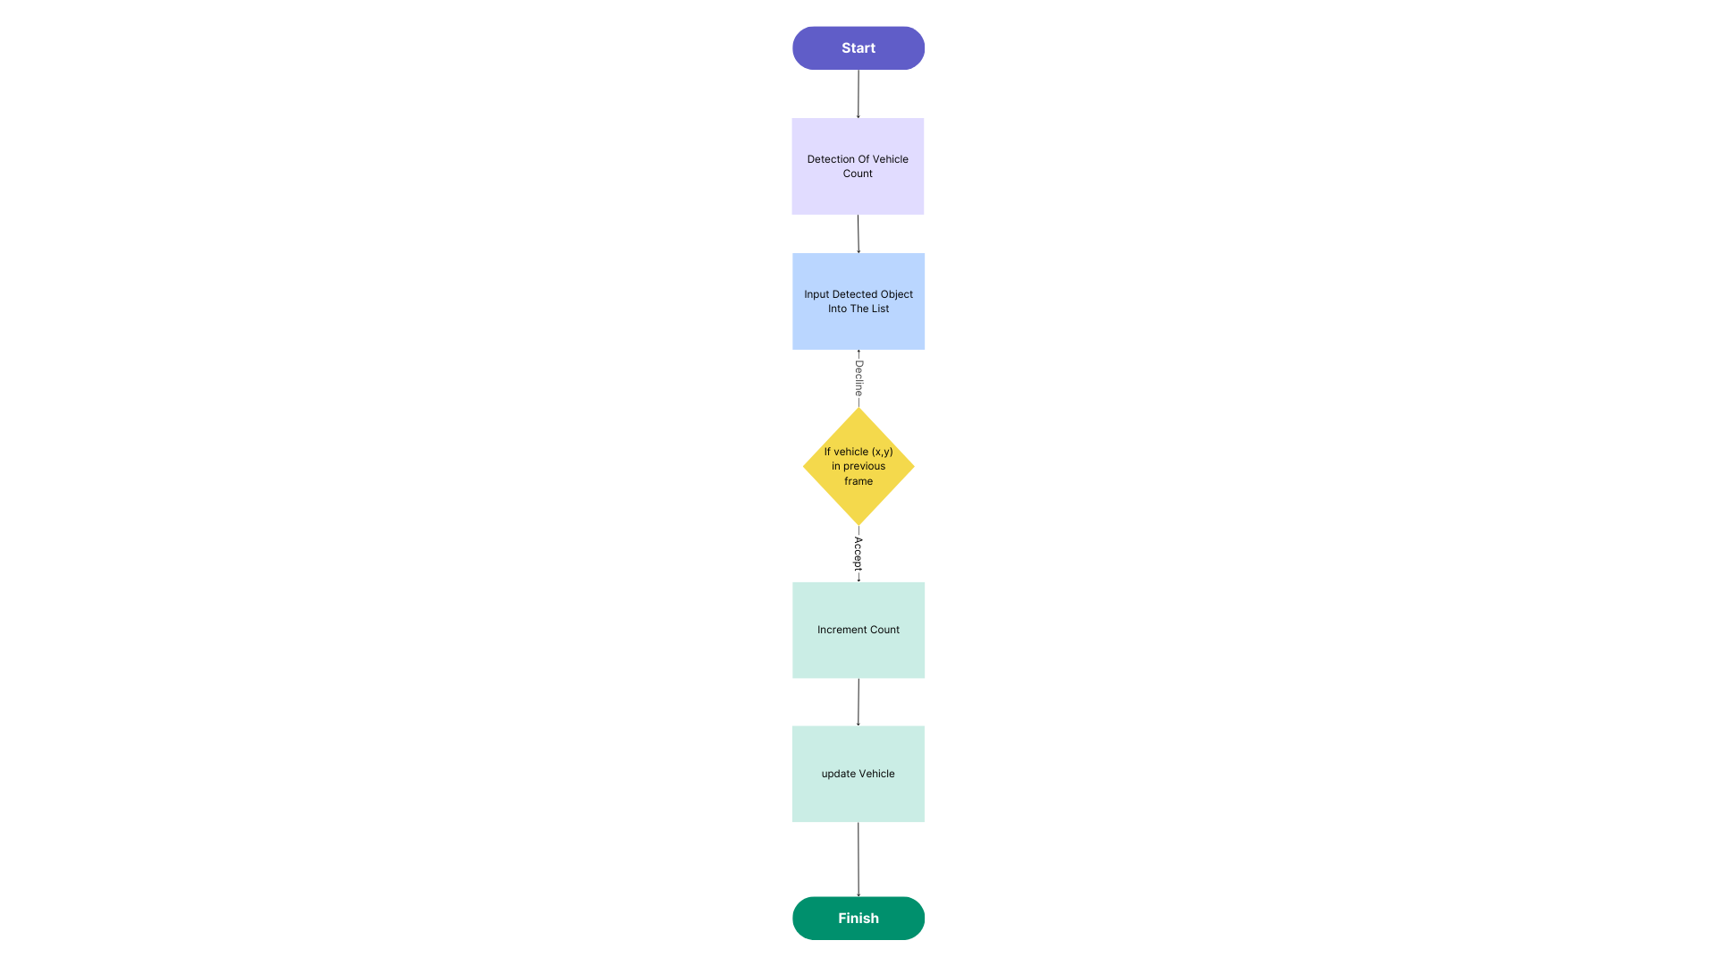
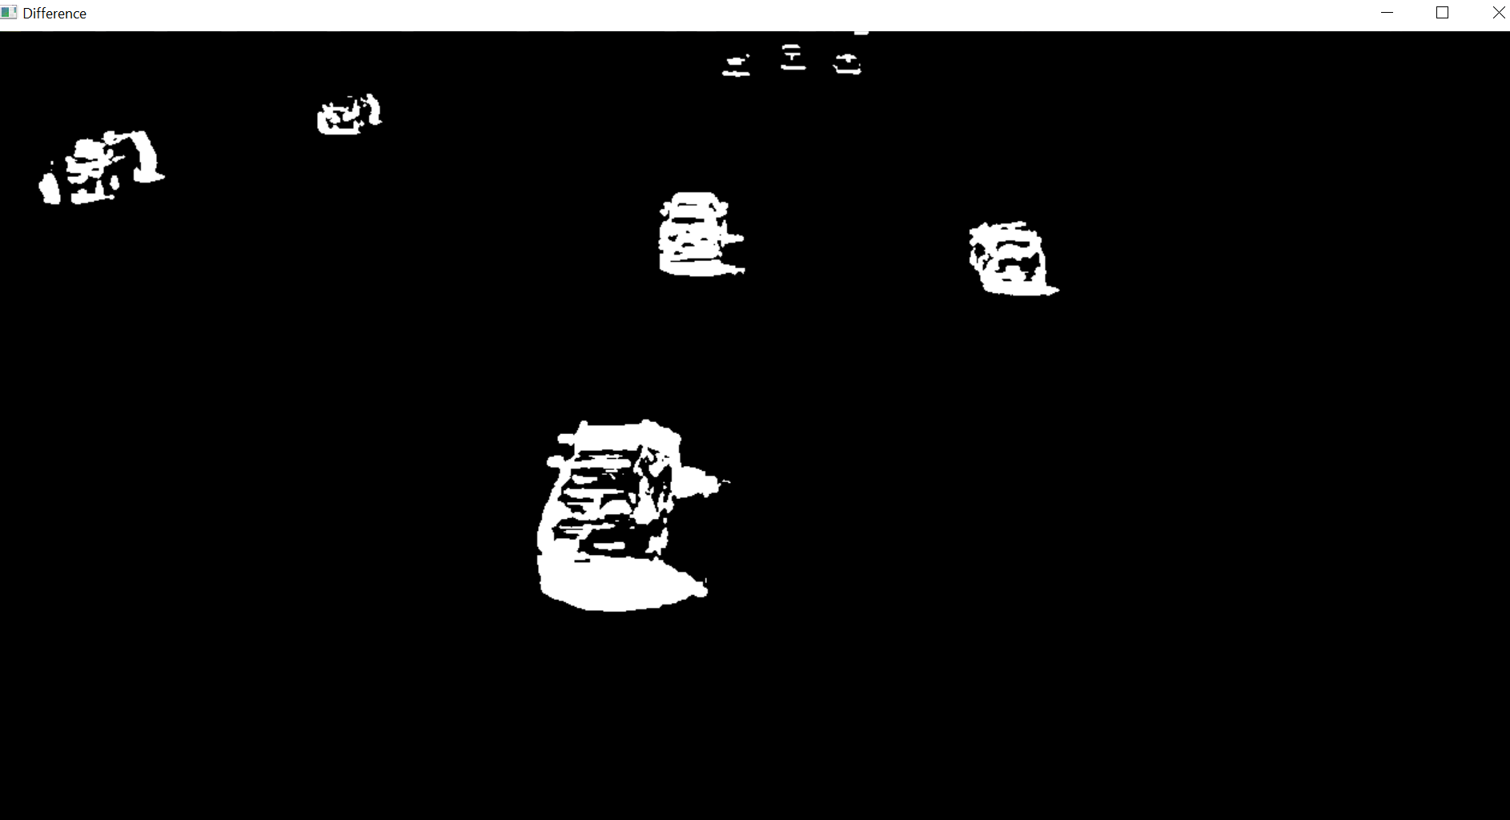
Flow Chart
Pseudo code of a proposed method:
Step1: foreground extraction
Step2: Region of Interest
Step3: detection of a vehicle
Step4: counting of a vehicle

Slide 7
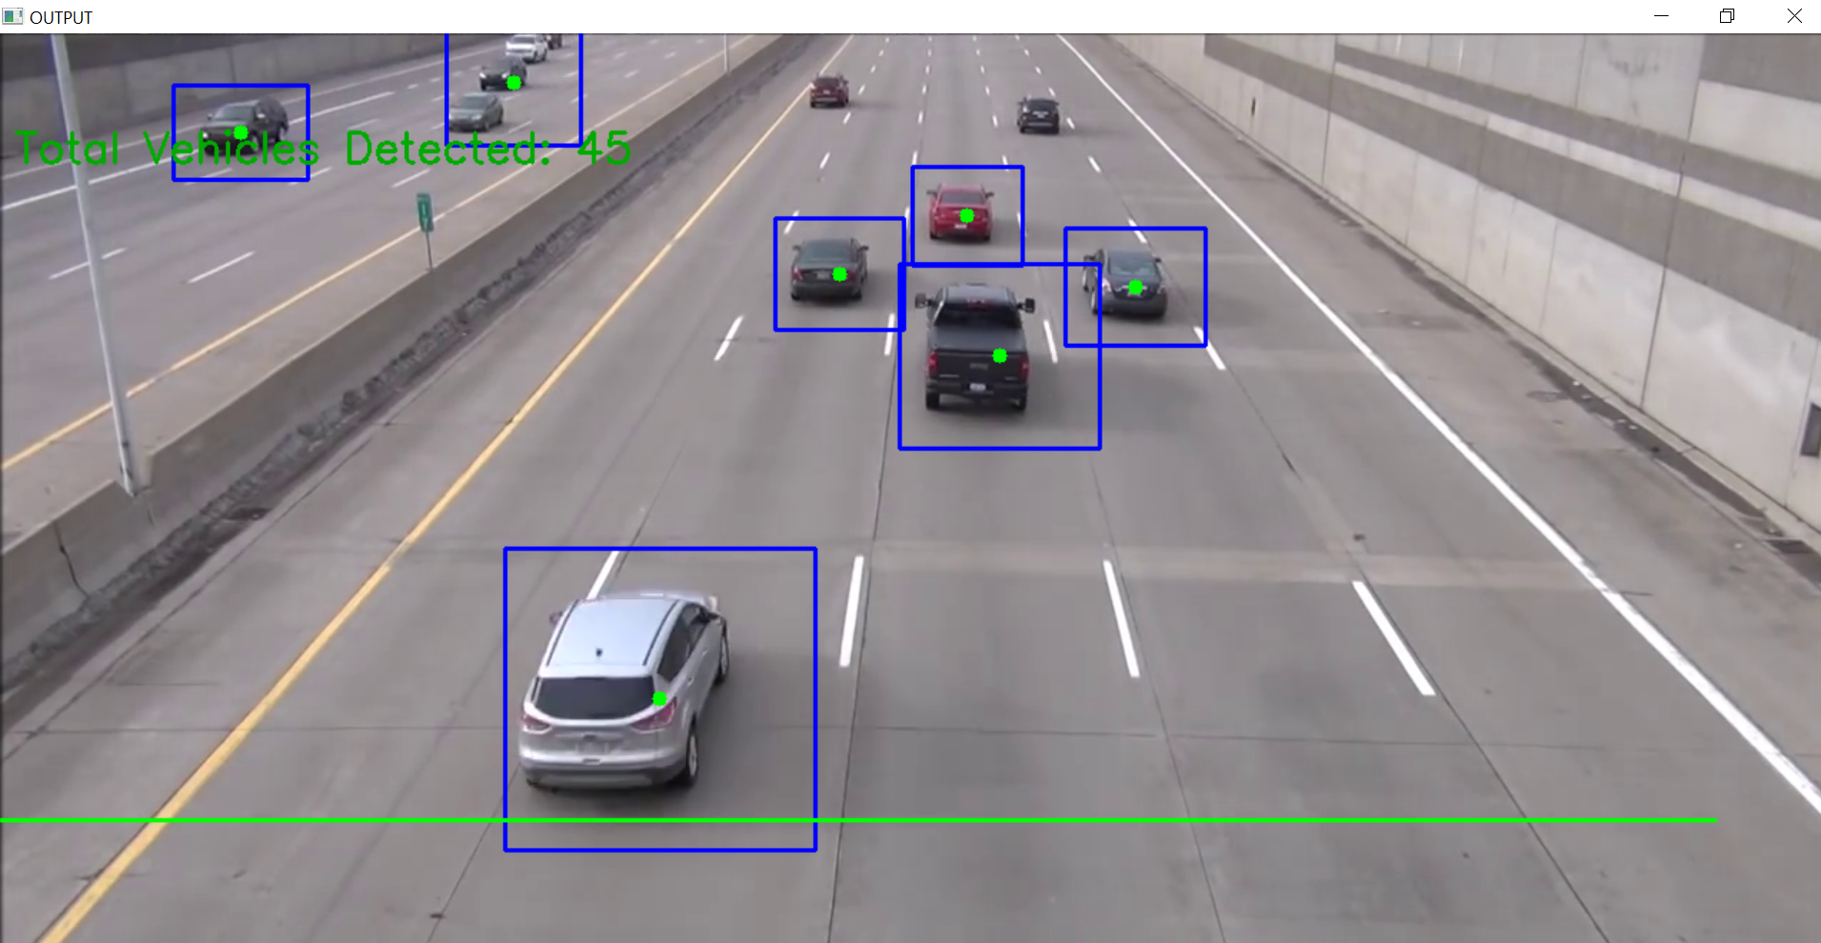
Result & Output
Exploratory outcomes appear in the above fig. The exactness of the proposed vehicle counting technique changed from 95-99%, based on the video input. It recommends that the proposed method could perform very well on each tried video. The 3 lines which are shown in the video is called region of interest. And it is also a part of virtual detection zone. Once the vehicle passes into that zone it will detected and counted as per sequential order. Up and Down is displayed at the top left corner. It is about displaying how many vehicles are reaching into the region is counted as down. And one which leaving is counted as up

Slide 8
The future scope of vehicle detection using OpenCV in Python can include:
1. Implementing advanced deep learning models for more accurate vehicle detection.
2. Integrating real-time video processing for dynamic traffic monitoring.
3. Enhancing detection performance in challenging conditions such as low light or adverse weather.
4. Implement the speedometer in our project to Detect the speed of the vehicle.
5. And We will collabrate with company to improve our product
Conclusion
In this paper, a methodology dependent on Python Lang has been proposed. Computer vision techniques are utilized to detect the vehicle and counted the number of a vehicles that are passing on a particular street utilizing highway videos as input. At last, the vehicles were recognized and counted when they passed into the virtual detection zone. Experimented outcomes showed that a precision of the proposed vehicle counting system was 96%.

Slide 9
References
[1] Xiang, X., Zhai, M., Lv, N., & El Saddik, A. (2018). Vehicle counting based on vehicle detection and tracking
from aerial videos. Sensors, 18(8), 2560.
[2] Song, H., Liang, H., Li, H., Dai, Z., & Yun, X. (2019). Vision-based vehicle detection and counting system using
deep learning in highway scenes. European Transport Research Review, 11(1), 1-16.
[3] Chhadikar, N., Bhamare, P., Patil, K., & Kumari, S. (2019, June). Image processing based Tracking and
Counting Vehicles. In 2019 3rd International Conference on Electronics, Communication and Aerospace
Technology (ICECA) (pp. 335-339). IEEE.
[4] Veni, S. S., Hiremath, A. S., Patil, M., Shinde, M., & Teli, A. (2021). Video-Based Detection, Counting and
Classification of Vehicles Using OpenCV. Available at SSRN 3769139.
[5] Kandalkar, P. A., & Dhok, G. P. (2017). Image Processing Based Vehicle Detection And Tracking System.
IARJSET International Advanced Research Journal in Science, Engineering and Technology ISO 3297: 2007
Certified, 4(11).

Slide 10
THANK YOU
www.yourwebsite.com

